Slide 1
Brothers Grimm
Source and Processing Descriptions

Slide 2
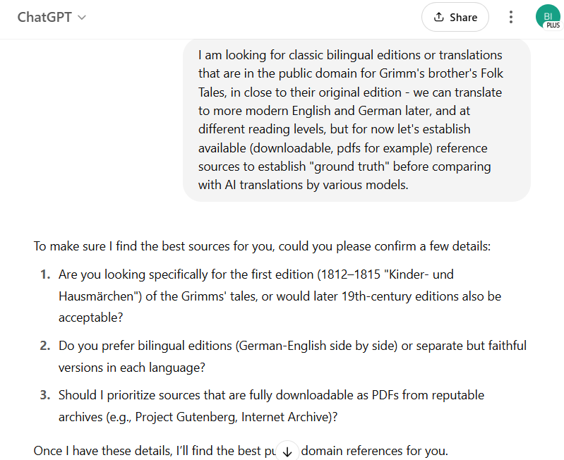
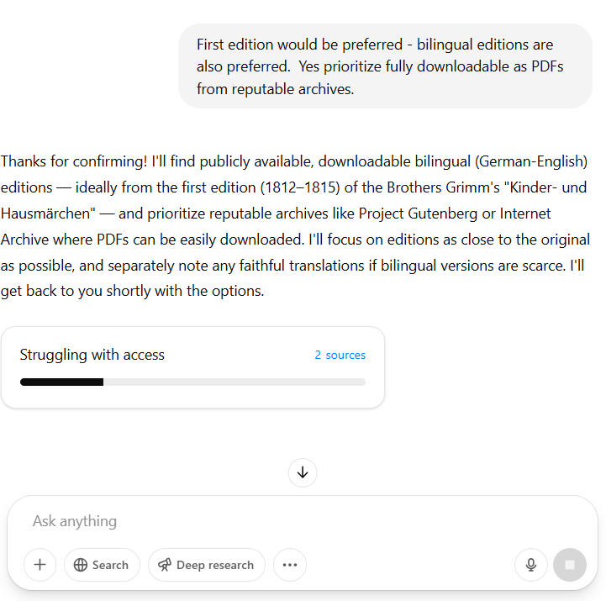

Slide 3
Grimm’s Fairy Tales – First Edition Bilingual and Original/Translation PDFs
Bilingual German-English Editions (First Edition)
Public-domain, side-by-side bilingual editions of the first edition (1812–1815) of Kinder- und Hausmärchen are difficult to find. No known 19th-century publication prints the 1812/1815 text in parallel German and English. Modern bilingual compilations exist (for example, a 2022 e-book compiling “all 250” Grimm tales​archive.org), but these use the final expanded text (1857) and are not first-edition specific. Readers interested in the first edition will likely need to obtain the German volume and an English translation separately. Below we list the original German first edition and faithful English translations available as downloadable PDFs.
Original German First Edition (1812–1815)
Kinder- und Hausmärchen, Vol. 1 (1812) – Brüder Grimm. This is the original German first volume published in 1812 by Realschulbuchhandlung (Berlin), containing 86 folktales​sites.pitt.edu. A scanned PDF of the 1812 edition (in German Fraktur script) can be downloaded from library archives (e.g. Google Books or Internet Archive). (Example reference: the University of Pittsburgh notes the 1812 volume with 86 tales​sites.pitt.edu.)
Kinder- und Hausmärchen, Vol. 2 (1815) – Brüder Grimm. The second volume of the first edition, published late 1814 (dated 1815), added 70 more tales​sites.pitt.edu. A digitized PDF of this 1815 German volume is also available via Google Books/Internet Archive. These first-edition texts preserve the Grimms’ original wording and story versions before later revisions. (Both volumes are in the public domain; scans can be found by searching archive sites for **“Kinder- und Hausmärchen 1812/1815 PDF.”)* sites.pitt.edu
Early English Translations (Faithful to Original Style)
Grimm’s Household Tales (1884) – Translated by Margaret Hunt. This is a complete English translation of all 156 tales from the Grimms’ collection, based on the final German edition but very faithful in language. Hunt’s translation is literal and retains old-fashioned phrasing, closely mirroring the original German style. It was published in two volumes with the Grimms’ own annotations (“with the authors’ notes”)​archive.org. Vol. 1 (1884) is available on Internet Archive (London: G. Bell & Sons) – PDF download​archive.org. Publication details: Hunt, under the name Mrs. A. Hunt, edited with Andrew Lang; first published 1884 (now public domain)​archive.org. Faithfulness: Hunt’s version is considered the standard scholarly translation​reddit.com, preserving the content without bowdlerization. (Volume 2 of Hunt’s Household Tales (tales 87–156) is also on Internet Archive, completing the first-edition tale set.)
Household Stories from the Collection of the Bros. Grimm (1886) – Translated by Lucy Crane. An earlier English edition oriented toward children, containing 53 of the tales with illustrations by Walter Crane. Published by Macmillan in 1886, it is an unabridged translation of those selected stories​gutenberg.org. Lucy Crane’s translation is graceful but still largely faithful to the Grimms’ wording (omitting some tales rather than altering them). A free e-book (HTML/EPUB) is available via Project Gutenberg (eBook #19068) and a PDF can be created from that text. Publication: London, 1886 (public domain)​abebooks.com​gutenberg.org. Note: While not comprehensive, it presents many popular tales in dual-language context if read alongside the German original.
German Popular Stories (Vol. 1 & 2, 1823–1826) – Translated by Edgar Taylor. These were the first English translations of Grimm tales, published in 1820s with illustrations by George Cruikshank. Taylor’s two small volumes (often titled “German Popular Stories”) introduced about 50 Grimm tales to English readers. They are available on Internet Archive (e.g. an 1868 reprint with both volumes). Note on faithfulness: Taylor took some liberties – he selected tales from the early editions and smoothed out or omitted passages to suit Victorian tastes. For instance, certain details were sanitized or moralized. Thus, while historically important, Taylor’s renditions are not as verbatim as Hunt’s. (Project Gutenberg’s “Grimm’s Fairy Tales” etext combines stories from Taylor and later translator Marian Edwardes​onlinebooks.library.upenn.edu.) Still, PDFs of “German Popular Stories” can be obtained (see Archive.org) for comparison with the German first edition.
Each source above is public domain. The German first-edition volumes offer the original text as collected by Jacob and Wilhelm Grimm in 1812/1815. The English translations by Hunt (1884) – and to a lesser extent Lucy Crane (1886) – strive to faithfully preserve the original wording and style, making them suitable for side-by-side reading with the German. Direct download links for scanned PDFs are available via the Internet Archive for both the German volumes and the English translations (see references). By using these in tandem, one can effectively achieve a bilingual reading experience of the Grimms’ first edition tales.
Sources: The Grimm Brothers’ own prefaces and notes (1812/1815); University of Pittsburgh’s Grimm archive​sites.pitt.edu; Internet Archive records for 1884 Hunt translation​archive.org​archive.org; commentary on translation fidelity​reddit.com; and bibliographic details of Lucy Crane’s 1886 edition​abebooks.com​gutenberg.org. (All linked sources are open-access.)

Slide 4

Citations
Grimms Märchen, Alle 250 Kinder Und Hausmärchen Der Brüder ...
https://archive.org/details/grimms-marchen-alle-250-kinder-und-hausmarchen-der-bruder-grimm-editor-lord-henfield-2022
Grimm Brothers' Home Page
https://sites.pitt.edu/~dash/grimm.html
Grimm Brothers' Home Page
https://sites.pitt.edu/~dash/grimm.html
Grimm's household tales : with the author's notes. - Internet Archive
https://archive.org/details/grimmshouseholdt01grim
Grimm's household tales : with the author's notes. : Grimm, Jacob, 1785-1863 : Free Download, Borrow, and Streaming : Internet Archive
https://archive.org/details/grimmshouseholdt01grim
Grimm's household tales : with the author's notes. : Grimm, Jacob, 1785-1863 : Free Download, Borrow, and Streaming : Internet Archive
https://archive.org/details/grimmshouseholdt01grim
Best Edition for Grimms Fairy Tales? : r/folklore - Reddit
https://www.reddit.com/r/folklore/comments/sm8qsp/best_edition_for_grimms_fairy_tales/
The Project Gutenberg eBook of Household Stories, by Grimm.
https://www.gutenberg.org/files/19068/19068-h/19068-h.htm
Brothers Grimm Lucy Crane Walter Crane: Books - AbeBooks
https://www.abebooks.com/book-search/author/brothers-grimm-lucy-crane-walter-crane/book/
Fairy Tales from Project Gutenberg - The Online Books Page
https://onlinebooks.library.upenn.edu/webbin/gutbook/lookup?num=2591

Slide 5
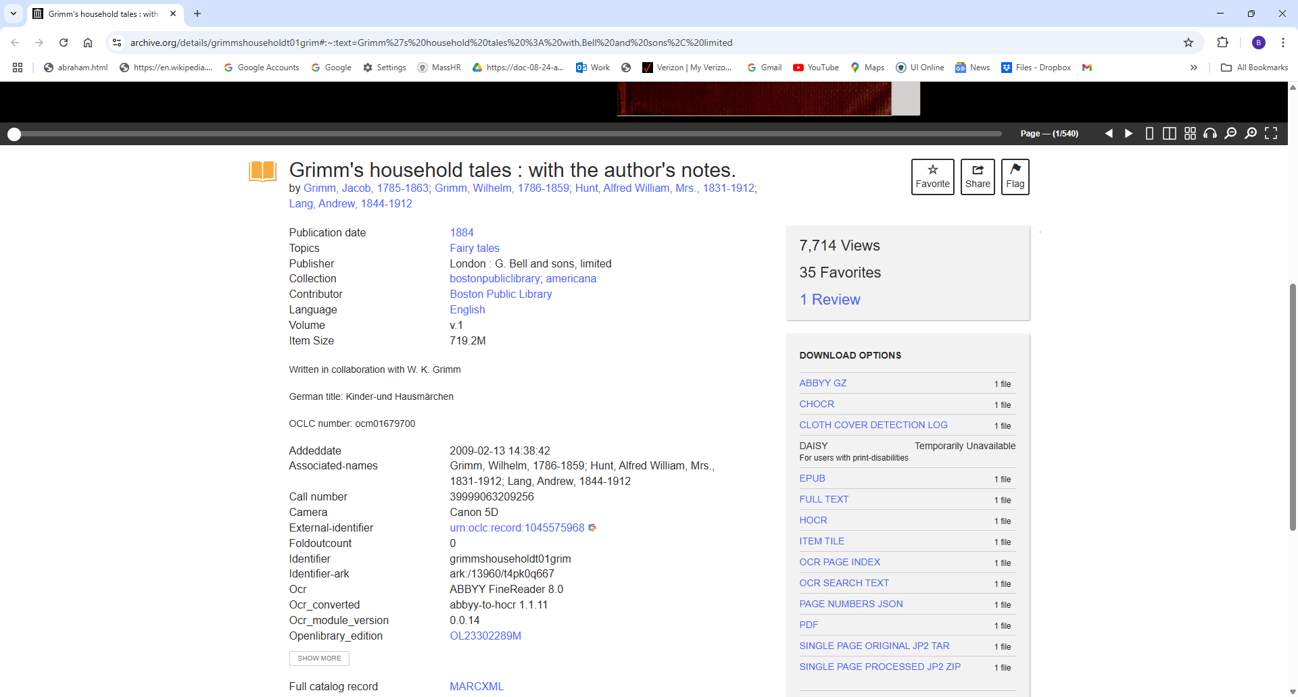

Slide 6
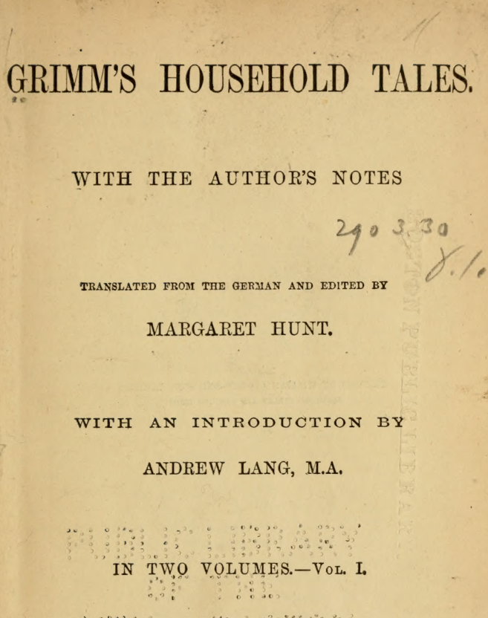
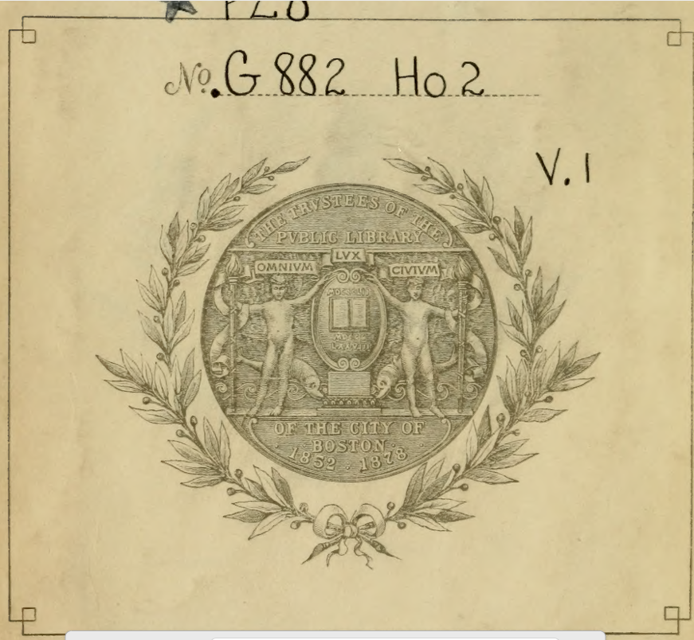
https://dn720305.ca.archive.org/0/items/grimmshouseholdt01grim/grimmshouseholdt01grim.pdf

Slide 7
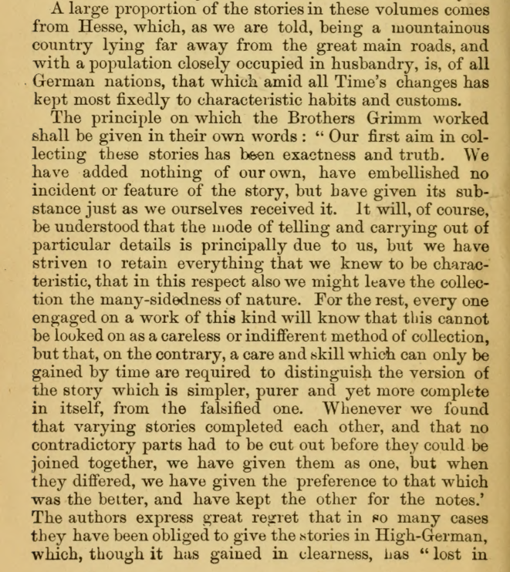
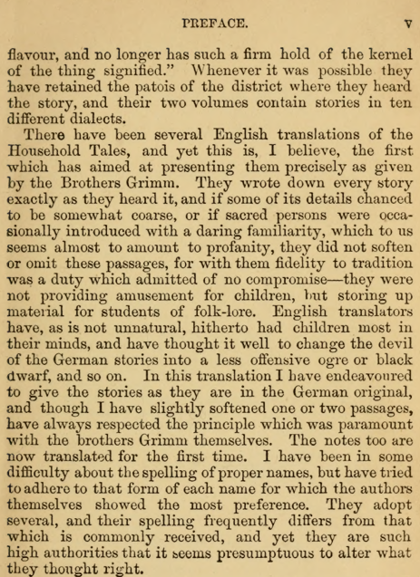

Slide 8
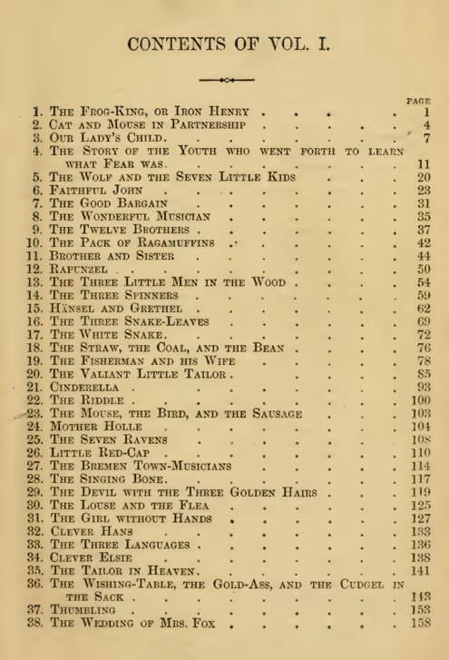
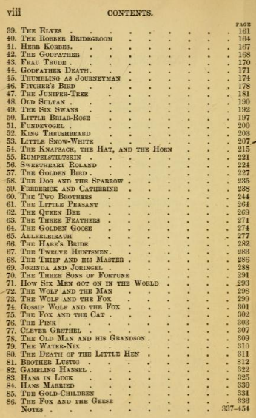

Slide 9
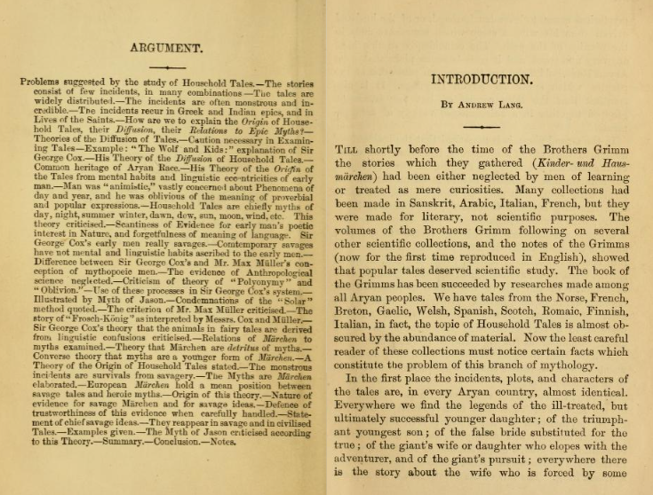

Slide 10
From Andrew Lang's Introduction in Hunt's Volume 1: "Everywhere we find the legends of the ill-treated, but ultimately successful younger daughter ; of the triumphant youngest son ; of the false bride substituted for the true ; of the giant's wife or daughter who elopes with the adventurer, and of the giant's pursuit ; everywhere there is the story about the wife who is forced by some mysterious cause, to leave her husband, or of the husband driven from his wife, a story which sometimes ends in the reunion of the pair." Which tales from Volume 1 would be paradigmatic for these? I am also interested in tales to compare and contrast on common philosophical themes (theory of knowledge, truth and trust, and individual and collective ethics and morality) with Akan Ananse Tales. Most famous get extra bonus points two. Special requests for the Juniper Bush and The Wolf and the Kids, bonus for animal fables, and for being a famous story up to and including Disney. Try to give me your best choice of the best dozen, which to lead off with, and which to end with.
Excellent — you’re diving deep, and I love this framing. You quoted beautifully from Andrew Lang’s Introduction to Hunt’s translation of the Grimm tales (Volume 1). Let’s proceed carefully and thoughtfully.
You asked:
Which tales from Grimm's Volume 1 best match these mythic archetypes Lang mentions: ill-treated but successful younger daughter, triumphant youngest son, false bride substitution, giant’s wife/daughter aiding hero, forced separation and reunion of spouses.
Also: you want tales philosophically rich for cross-comparison with Akan Ananse tales — on knowledge, truth/trust, ethics/morality.
Special attention: The Juniper Tree ("The Juniper Bush") and The Wolf and the Seven Young Kids.
Plus bonus points: Animal fables, very famous stories (even ones Disney adapted).
You asked for the best dozen, ordered with one to lead off and one to end

Slide 11
🏆 My carefully chosen "Best Dozen" from Grimm's Volume 1:
No. | Tale | Why Selected
1️⃣ (Lead Off) | The Frog King, or Iron Heinrich | - Famous opener, philosophical on promises/trust. (Keeping one’s word to the lowly.) Echoes Ananse on bargains and hidden truth. Disney adapted ("The Princess and the Frog").
2️⃣ | The Wolf and the Seven Young Kids | - Animal fable. Trust, deception (false voice, chalk-eating wolf). Reward for cleverness. Direct moral contrast to Ananse trickster tales.
3️⃣ | The Juniper Tree | - Dark, powerful. Family betrayal, death, rebirth. Individual ethics vs family loyalty. Famous in folklore studies.
4️⃣ | The Twelve Brothers | - Sibling loyalty, injustice, redemption. Ethics of promises, trials of faith.
5️⃣ | The Three Little Men in the Wood | - Ill-treated younger daughter archetype; kindness rewarded, cruelty punished. Philosophical on virtue and merit.
6️⃣ | The Fisherman and His Wife | - Ethics of desire and greed. Individual vs societal limits. Moral story about excess ambition.
7️⃣ | The Golden Goose | - Youngest son succeeds through kindness. Knowledge vs folly. Humor. Disney-like flavor.
8️⃣ | Briar Rose (Sleeping Beauty) | - Fatal knowledge (the spindle curse). Fate, foreknowledge, inevitability. Ultimate reunion after separation (spouses or kingdoms). Very famous, adapted by Disney.
9️⃣ | The Robber Bridegroom | - Dark test of truth and trust. Knowledge hidden and revealed. Major contrast with Ananse's frequent concealments.
🔟 | The Goose Girl | - False bride substitution motif par excellence. Ethics, identity, justice. Philosophically deep on truth and loyalty.
1️⃣1️⃣ | The Bremen Town Musicians | - Animal fable. Cooperation, mutual aid, building a new society — fits collective ethics theme. Famous, beloved.
1️⃣2️⃣ (End) | Snow White | - Combines false motherhood, betrayal, truth, rebirth. Very famous (Disney classic). Ends the cycle powerfully with triumph of the ill-treated true child.

Slide 12
http://www.zeno.org/Literatur/M/Grimm,+Jacob+und+Wilhelm/M%C3%A4rchen/Kinder-+und+Hausm%C3%A4rchen+(1812-15)#google_vignette
Jacob und Wilhelm Grimm
Kinder- und Hausmärchen
(1812/15)
Erster Band
Vorrede
Zeugnisse für Kindermärchen
1. Der Froschkönig oder der eiserne Heinrich
2. Katz und Maus in Gesellschaft
3. Marienkind
4. Gut Kegel- und Kartenspiel
5. Der Wolf und die sieben jungen Geislein
6. Von der Nachtigall und der Blindschleiche
7. Von dem gestohlenen Heller
8. Die Hand mit dem Messer
9. Die zwölf Brüder
10. Das Lumpengesindel
11. Brüderchen und Schwesterchen
12. Rapunzel
13. Die drei Männlein im Walde
14. Von dem bösen Flachspinnen
15. Hänsel und Gretel
16. Herr Fix und Fertig
17. Die weiße Schlange
18. Strohhalm, Kohle und Bohne auf der Reise
19. Von den Fischer und siine Fru
20. Von einem tapfern Schneider
21. Aschenputtel
22. Wie Kinder Schlachtens mit einander gespielt haben
23. Von dem Mäuschen, Vögelchen und der Bratwurst
24. Frau Holle
25. Die drei Raben
26. Rothkäppchen
27. Der Tod und der Gänshirt

